Slide 1

REVOLUTION IN THE TECH INDUSTRY BY AFRICAN WOMEN.

Slide 2
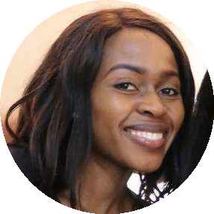
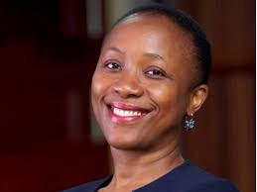
PENDO MANJELE
Solution developer & integrations specialist.
Currently working at united bank of Africa PLC.
SUSAN M’KANDAWIRE MULIKITA
C.E.O at liquid telecom Zambia.
Buckinghamshire University.

Slide 3
SYLVIA MUKASA
From Kenya .
C.E.O of global X investments Limited.
A representative of Faster Capital.
Ambassador of Next Einstein Forum.
Country Co-founder/chapter lead Kenya (women in Tech Africa).
A professional with considerable hands-on-experience in strategy planning & business development.

Slide 4
SELASIE DZIKUNU
Management consultant and chapter lead from Ghana.
ELIZABETH OLORUNLEKE
08/1988.
South western region of Nigeria.
Founder of inspirasoft.com.
BSC in comp engineering & science.
tech4Her project on going.

Slide 5
LOLA BANJO
Great new York city area.
Strategy innovation & executive.
Is knowledgeable on the economic levers & cultural uniqueness that drives how business is conducted in various parts of the globe.

Slide 6
ETHEL COFIE
Founder C.E.O of EDEL technology consulting a women in tech Africa.
Named one of the top 5 women impacting IT in Africa.
Created “Women in tech”.
MABEL AIDOO
Ghana.
Tigo advisor at millicom.
University of cape town.
Pursued accounting and business management.

Slide 7
JUDITH OWIGAR
Social entrepreneur.
ICT advisor – urban basic service branch.
Founder & C.E.O juakali work force limited.
Co-founder Akirachix association.
Board member SPIDER.
Girl lab technology partner, Nike foundation.

Slide 8
LINDA KAMAU
Kenya.
Managing director and co-founder Akirachix.
Lead developer ushahidi platform.
Stanford university graduate school of business.
Executive program social entrepreneurship.
2019 university teknologi kreatif limkokwing-Malaysia.

Slide 9
SANDRA CHIMPALA
A tech blogger and analyst at techtrends Zambia.
A digital media specialist.
Worked with Africa internet group under Kamuyu Rock FM & power fm.
Currently with the BBC media action in curating digital content for it’s projects.
Mentor partner media outlets.

Slide 10
GRATITUDE

